Slide 1

Java + MySQL Parte 10
Prof. Anderson Vanin

Slide 2
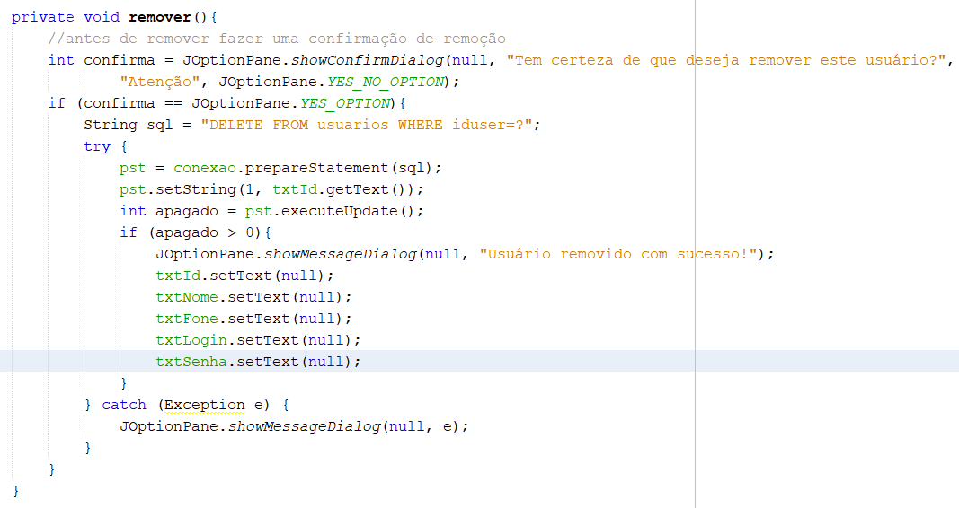

ActionPerformed do botão Remover

